Slide 1
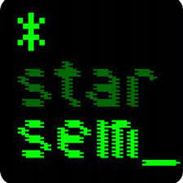





Seeking Clozure: Robust Hypernym Extraction from BERT with Anchored Prompts
*
*SEM 2023
Chunhua Liu Trevor Cohn* Lea Frermann
Notes:
Hi everyone, I’m Chunhua Liu, from the University of Melbourne.
Today I’m going to present our paper accepted by *SEM 2023. This work is collaborated with Trevor Cohn and Lea Frermann.
The title is seeking closure: robust hypnym etraction from BERT with anchored prompts.

Slide 2
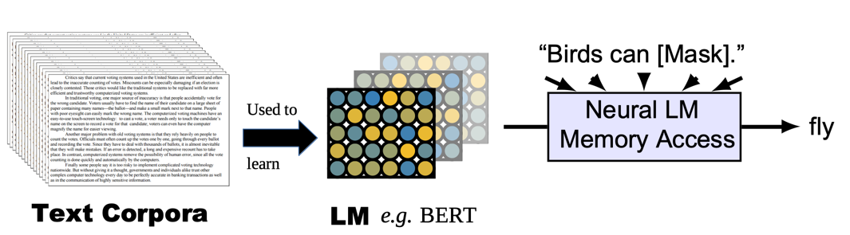
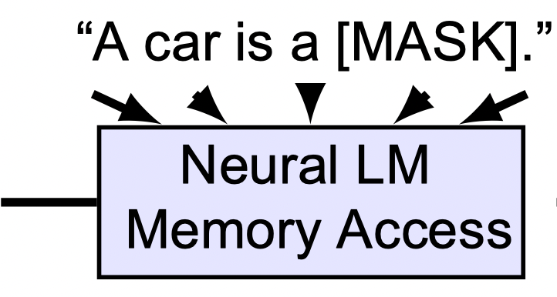

Motivation
Querying language models (LM) for hypernym (Is-A) knowledge
(Petroni et al., 2019; Feldman et al., 2019)
Notes:
Inspired by: https://maartensap.com/acl2020-commonsense/slides/05%20-%20neural%20integration%20part%202.pdf
This paper is motivated by recent work in using language models as knowledge base to extract structure knowledge.
In this work, we focus on hypernym extraction, or the Is-A relational knowledge.
This relationship serves as a backbone of concept categorization and ontology construction
Language models capture rich knowledge by training on large corpora.
However, those knowledge are hidden in their parameters and not easily accessible.
So how can we better understand what's inside these language models remains to be an open question.
One straightforward way is to give a prompt to the language model. For example, if we want to know the hypernym of ‘car’,
we might provide the prompt: ”A car is a [MASK]...". And ask the language model to predict the most likely word to fill the MASK token, for example, vehicle.

Slide 3




Motivation
vehicle
Capture affirmative context (Petroni et al. 2019; Weir et al. 2020; Shwartz et al. 2020)
A car is a __
Fail on challenge scenarios:
Fail on uncommon concepts (Schick and Schütze, 2019)
Inconsistent predictions on singular and plural paraphrased hypernymy probes (Ravichander et al., 2020)
A kea is a __
fish
Cars are __
trees
Notes:
However, the results in recent studies are mixed.
On the one hand, these pre-trained language models can capture affirmative context, for instance, correctly identifying a car is a vehicle.
On the other hand, the models struggled with more complex scenarios,
such as dealing with uncommon concepts, for example, failed to predict the hypernym for the rare word kea
And they are sensitive to the surface forms of prompts, and make inconsistent predictions on paraphrased prompts.
For example, the model can predict a car is a vehicle, but fail to identify the hypernym when paraphrased with “cars are __” .
In this study, we look closer into those challenge scenarios on hypernym extraction.

Slide 4
Research Question and Contribution
Can we identify effective approaches to extract hypernym knowledge within pre-trained language models?
We propose to use well-established patterns from corpus-mining to improve the hypernym extraction.
Notes:
We ask:
Can we identify effective approaches to extract the hypernym knowledge within pre-trained language models?
How can we construct better prompts?
After all, when we break down what makes up prompts, they're essentially made up of patterns, right?
The acquisition of hypernyms has been a long-standing research question, studied since the early 1990s.
Many established patterns have been shown to be effective in extracting hypernyms from raw collections of text.
However, these patterns have not been fully utilized to construct prompts.
So, we propose to bridge the gap by connecting the long line work on pattern-based approach with the current prompting method.
----
Hypernym acquisition has been a long-standing research question, starting since early 1990s.
There are many well-established patterns that have been shown effective for hypernym extraction from raw corpus.
But those patterns are not well used in prompting.
So we propose to connect the long line work on pattern-based hypernym extraction with the current prompting method.
----
We propose to use established methods from corpus-mining to improve the hypernym extraction

Slide 5
Anchored Patterns for Hypernym Acquisition
Anchored pattern: <Y> such as X and Z
Z : acts as an anchor for X, aiding the hypernym identification
Discovering hypernyms using two concepts that are siblings (Hearst., 1992; Hovy et al., 2009)
bird
kea
parrot
Anchors can provide external information for uncommon X
Notes:
We reviewed patterns that are effective for hypernym extraction from raw corpora.
We found that the anchored patterns can potentially tackle those challenge scenarios faced in prompting LM.
On example of the anchored patterns is <Y> such as X and Z
Here the 'Z' is referred as the anchor, which is used to help to the hypernym identifcaton
The key idea of anchored patterns is to discover hypernyms using siblings
To illustrate, if we have the word 'mouse', and we want to predict its hypernym, it could be animal or device. But if we know the anchor is 'computer', then it can help us identify the hypernym 'device' rather than 'animal’.
So, anchor can reduce ambiguity for the X.
Additionally, it can provide more context information for rare X. For instance, we want to predict the hypernym for okapi', but we don't know what it is because it’s n uncommon word. However, if we know that 'giraffe' is its anchor, then it can help us to predict the hypernym mammal.
-----
We found that the earliest intuition comes from Hearst in 1990s, which uses the lexico-syntactic patterns to identify the hyponym-hypernyms pairs.
In later work, Hovy use this pattern to build ontology.

Slide 6
Anchored Prompts
A kea is a __
fish
Incorporate anchors into prompts
Prompting LMs with a set of patterns and their anchored version.
A kea or parrot is a __
bird
Raw Patterns
A(n) X is a Y. A(n) X is a type of Y. A(n) X is a kind of Y.
+Anchor
A(n) X or Z is a Y. A(n) X or Z is a type of Y. A(n) X or Z is a kind of Y.
Notes:
In this work, we incorporate the idea anchor patterns into the context of prompting language models. We construct anchored prompts to extract hypernym.
For example, the original prompt is A Kea is a __
We identify the anchor of kea is parrot and then incorporate it into the original prompt to get the anchored prompts
To avoid situations where the language model might be sensitive to a single pattern. we use a set of patterns and aggregate the results of them
Similarly, we construct their anchored versions.
However, the Z in the anchored patterns are unknown.

Slide 7
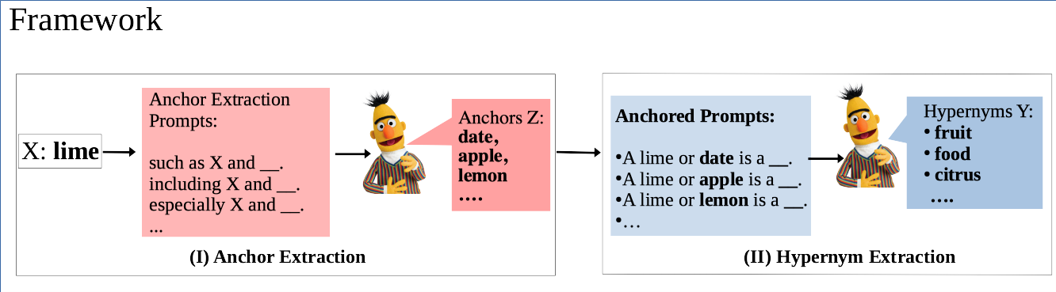
How to effectively construct anchored prompts for hypernym extraction?
Notes:
We propose to automatically mine anchors and hypernyms from pre-trained language models using two steps.
Firstly, we use a set of effective patterns that can indicate the siblings relations between two words to mine the anchors.
For example, such as X and Z, including X and Z.
%Given the word lime, we feed it into the set of siblings patterns to get prompts and (reduce the details if you need more time?)
Then we use BERT model to predict the likely anchors with scores
We rank anchors by their average probabilities across prompts #that generate them among top 10 predictions
Then we get a list of likely anchors, for example, date, apple.
In the second step, we use the anchors to construct anchored prompts for hypernym extraction.
Similarly, the hypernyms are ranked based on their average probabilities across prompts
---------
We aggregate the anchors across all prompts and select the top 5 anchors.
Those anchors are are then inserted back into our hypernym extraction patterns to construct anchored prompts for hypernym extraction.
Similarly, the final hypernyms are aggregated across the list of prompts and ranked to compare against ground truth hypernyms.

Slide 8
Experimental Set up
Model: BERT + top 5 anchors
Evaluation: (I) anchor extraction and (II) hypernym extraction
Evaluation metric:
Precision at K (P@K), to measure if the correct anchors/hypernyms are among the top K model predictions
Data set: six hypernym datasets
BLESS (Baroni and Lenci, 2011), DIAG (Ravichander et al., 2020), CLSB (Devereux et al., 2014), SHWARTZ (Shwartz et al., 2017), LEDS (Baroni et al., 2012), EVAL (Santus et al., 2015)
Analysis under varying data conditions
frequency, abstractness, consistency across paraphrasing
Notes:
To evaluate the framework
We conduct at case study using BERT, which has been widely used in prior work to understand hypernyms in the pre-trained language model.
We evaluate the two steps of our framework
With precision @K, which measures if the correct anchors/hypernyms are among the top K model predictions
We conduct experiments on six widely-used English datasets
And we analyse the performance under different data conditions
-----
Our goal is to gain a deeper understanding of the inner workings of this process. More specifically, we aim to determine whether anchored prompts can help us tackle challenges. To answer this question, we conducted a case study on BERT, analysing the performance of hypernym-extraction under different scenarios such as frequency, abstractness, and consistency across our prompt set.
We evaluated the model's performance using "position at 10", which examines whether the ground truth hypernym occurs in the top 10 model predictions. We conducted the experiments across six hyponym datasets, merging all of our datasets for the analysis.

Slide 9
Anchor Validation
Qualitative inspection of anchors with WordNet siblings (Schick and Schütze., 2020)
X | Top 5 predicted anchors (Z)
car | truck, motorcycle, boat, yes, bike
apple | grape, pear, nuts, vegetable, date
train | bus, plane, car, tram, truck
corn | bean, potato, barley, wheat, pea
X | Top 5 predicted anchors (Z)
motel | hotel, yes, sure, restaurant, actually
daisy | rose, yes, lavender, rush, fern
murre | dog, bird, fox, crow, rabbit
trireme | warship, frigate, ship, ferry, battleship
(a) High overlap of Z and WordNet Siblings
(b) Z not in WordNet Siblings
Retrieved anchors often reasonable even if not WordNet siblings.
Notes:
Firstly, following prior work, we validate how accurate the anchors are using wordNet siblings.
We qualitatively inspect the anchors using WordNet siblings.
% Which are the words that share common ancestors.
%To avoid too generic siblings, following prior work, we constrain the ancestor to be 2 level above x and 4 levels above z.
firstly, we observe that some concepts have high-overlap of anchors with WordNet siblings, such as car, train as shown here.
We also observe that for some concepts, anchors are not in WordNet siblings based on our constrain,
But they are often reasonable, such as motel and hotel, daisy and rose
We also conducted quantitative evaluation on the six datasets. Please check more details in our paper
Next, we analyze how anchored prompts perform under different data conditions.
---------
What’s the hypernym of motel in the dataset LEDS? Building
Why motel is not in WN siblings? Hotel is the hypernym of motel in WordNet not co-hyponyms
Why daisy and rose are not in WN siblings?
They are too far away (7 hops between (daisy and rose) > more than 6 hops (our constrain)
Rose (the dusty pink color) flower is not the top 2 senses of Rose
The first sense is (any of many shrubs of the genus Rosa that bear roses)
Including some frequent words, for example, motel and hotel, daisy and rose,
And some rare words, such as murre, which is kind of seabird or trireme, which is an ancient Greek war ship.
explain some wrong predictions such as yes, actually.
Please check more details in our paper
Which might the due to the complex sense difference make it too too far away from each other. For example, motel and hotel has xx hops in WordNet.

Slide 10
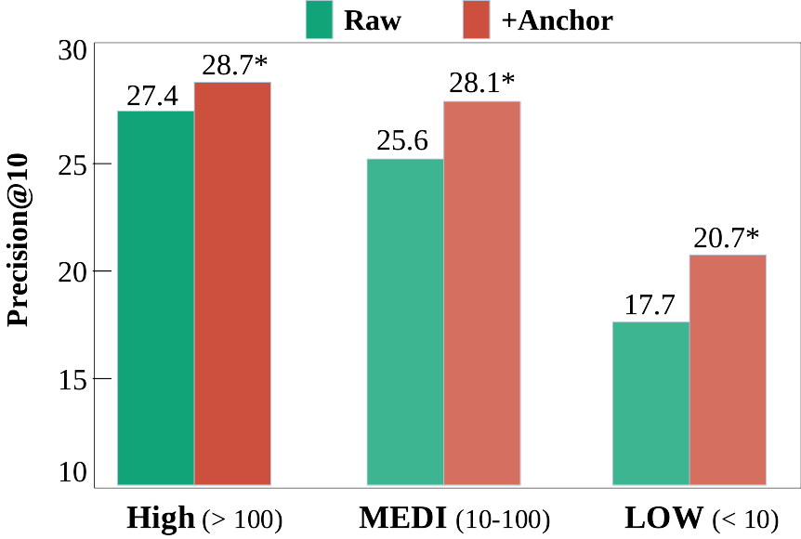
Results I: Anchor effects on hyponym frequency
Word frequency from WorldLex (Gimenes and New, 2015)
Key observations:
Anchors improve the overall performance, especially on low frequent words
* indicates significant difference (p < 0.05) of RAW vs. Anchored prompts
Notes:
https://app.flourish.studio/visualisation/13830319/edit
We first look at the anchors effects on hyponym frequency ( we didn't report the hypernym cause they are all frequent)
We obtain their corpus frequency from WorldLex and put them into three categories (HIG, MDEI and LOW).
Here we present the results from RAW and Anchored prompts,
Anchors improve the overall performance, especially for the low frequent words. This aligns with our previous hypothesis that anchors can provide additional information for uncommon words.
---
If the word count is higher than 100, we consider it frequent; if it's between 10 and 100, we label its frequency as medium; and if it's lower than 10, it's deemed infrequent. Observing the model's performance without an anchor, we find it performs considerably worse on infrequent words. However, incorporating anchors significantly improves performance across all frequency levels.

Slide 11
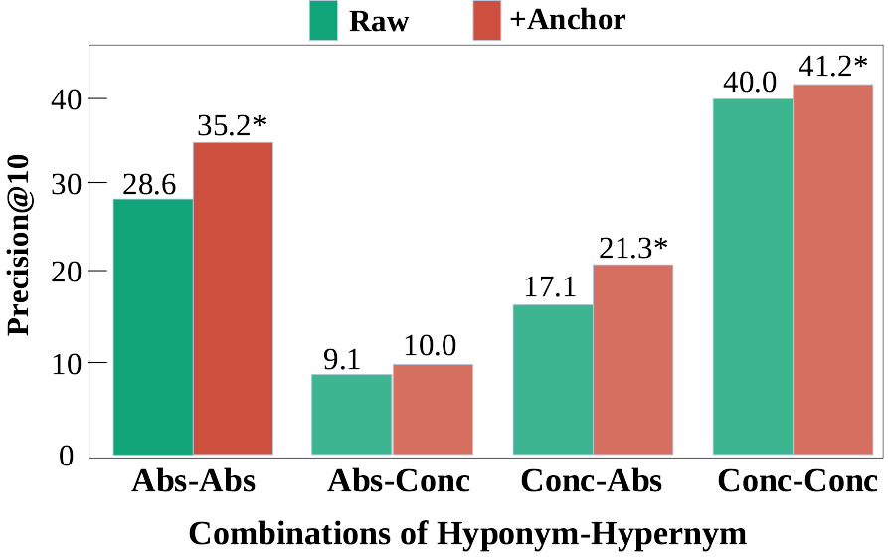
Results II: Anchor effects on concept abstractness
Brysbaert's Abstractness Score (2014): Scale of 1-5
Abstract (< 3) and Concrete (≥ 3)
Key observations:
Models fail on abstract hypernyms e.g., emotion, organization, language
Anchors largely boost performance on abstract hypernyms
Notes:
https://app.flourish.studio/visualisation/13830389/edit?&folder=%1EPhD_Thesis
We did the same analysis on the concept abstractness,
by breaking down words into abstractness scores and levels.
Here, we show the performance of four combinations of hyponym-hypernym
We observed
- higher performance when the abstractness levels are the same because they tend to co-occur together
- but the performance is worse on abstract hypernyms
- providing anchors can largely boost the performance
This finding is encouraging because it points to the weakness of using hyponyms alone to prompt PLMs for abstract hypernyms and it shows that anchors can mitigate the gap between concrete and abstract hypernyms.
---
We observed lower performance when the abstractness level differs, which is shown in the middle.
Then we can see that incorporating anchors boost overall performance, especially on abstract hypernym, as shown in the first and third group.
Our closer inspection found that model often fail to predict the hypernym such as emotion, organization and language.
This is encouraging because

Slide 12
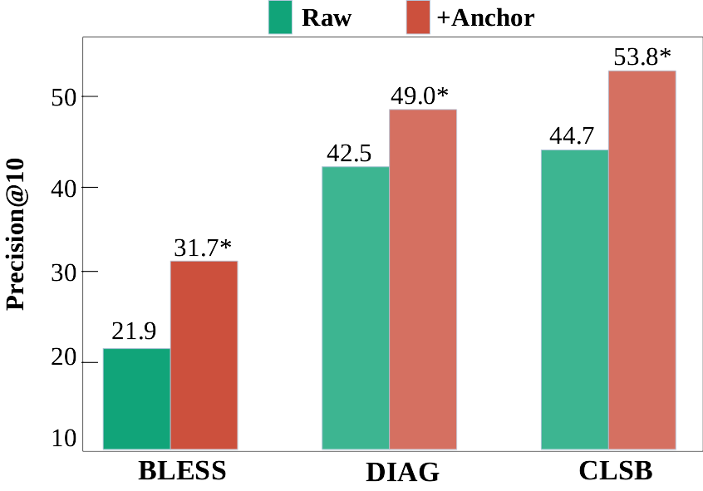
Results III: consistency across paraphrasing
Consistent: if a hypernym was correctly predicted by all prompt paraphrases in a set
Key observations:
Anchors boost the consistency across paraphrased prompts
Notes:
The figure is created via Flourish:
https://app.flourish.studio/visualisation/13830130/edit Next, we examine the consistency across praraphrase.
if a hypernym was consistently predicted by all prompts in a set, it's consistent. Consistency is an important evaluation metric for us to understand how reliable the extracted hypernyms are. Our results on different datasets show clear performance improvements when incorporating anchors.
Here we presented results on three dataset for illustration.
This shows that by accessing to anchors, model can return more robust hypernym knowledge.

Slide 13
How do anchors improve consistency?
We analyse hypernym predictions that are inconsistent without anchors but correct with anchors.
Cause of the inconsistency in non-anchored patterns:
overly generic predictions e.g., things or items;
predictions of siblings instead of hypernyms
e.g., a dog is a cat, which takes 30% of predictions from pattern A X is a Y
Access to anchors improved consistency by providing more nuanced and specific information.
Notes:
But how do anchors improve consistency:
To understand this
We analyse hypernym predictions that are inconsistent without anchors but correct with anchors.
We found two main cause of the inconsistency in non-anchored patterns:
Including the too broad predictions of hypernyms, such as things, or items.
Or the confusion of hypernyms with co-hypoyms or siblings, for example, a dog is a cat, which takes over 30% of predictions from the pattern A X is a Y
Anchors can provide more hierarchical information and external context to improve the consistency.
The anchors also add more constrains for the prediction.

Slide 14
Takeaway
Bridging pattern-based and prompting-based hypernym extraction
Anchored prompts improve challenge scenarios
Anchors prompts largely boost the hypernym consistency of hypernym extraction in paraphrase prompts
Notes:
Take a summary,
In this study we draw connection between the long line of pattern-based hypernym extraction with prompt-based approach
We show show that anchored prompts improve challenge scenarios and unlock more hidden knowledge in pre-trained language models
Anchored prompts can retrieve more robust hypernym knowledge.
Finally, I want to say although our work is mostly done before recent work of prompting large language models such as ChatGPT, but the essence of anchored prompts is similar, which is to decompose a difficult prompt into multiple sub-prompts and provide more detailed information so that the model can think step-by-step and return better results.

Slide 15

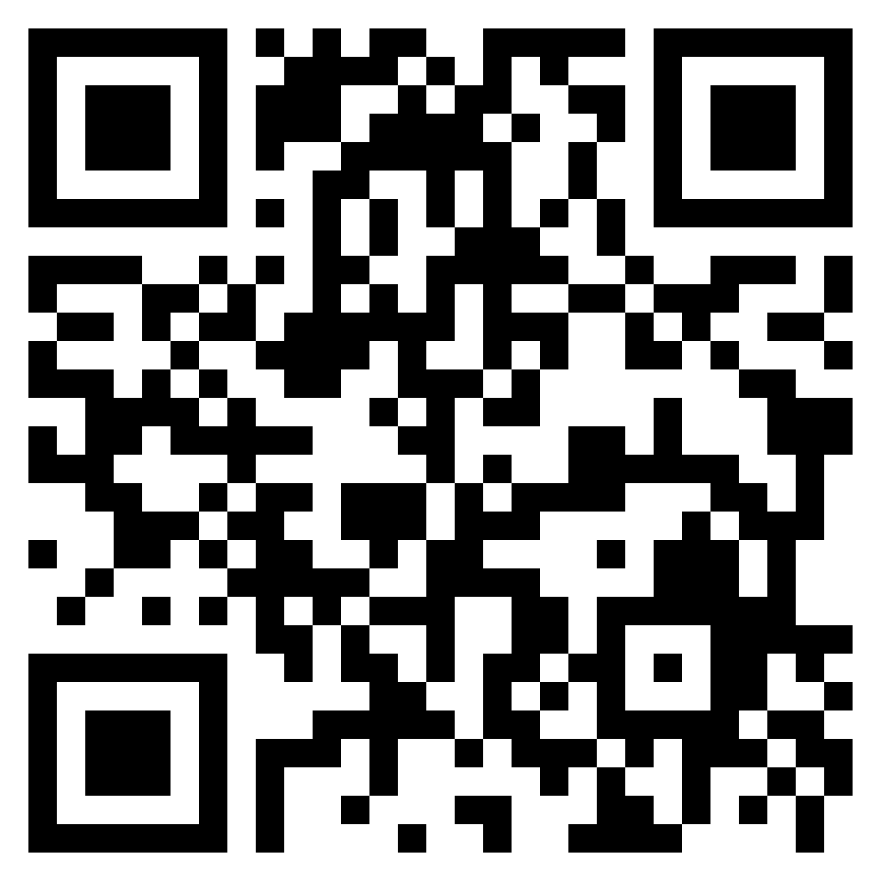
Thank you !
Any questions?
Find our code here
https://github.com/ChunhuaLiu596/AnchoredPrompts
Email: chunhua@student.unimelb.edu.au
Notes:
Thanks for your listening!
Feel free to reach out if you have any questions.

Slide 16
Anchored Patterns for Hypernym Acquisition
Anchored pattern: <Y> such as X and Z
Z : acts as an anchor for X, aiding the hypernym identification
Discovering hypernyms using two concepts that are siblings (Hearst., 1992; Hovy et al., 2009)
device
bird
mouse
computer
kea
parrot
(a) Reduce ambiguity for X
(b) Provide external information for uncommon X
Notes:
We reviewed patterns that are effective for hypernym extraction from raw corpora.
We found that the anchored patterns can potentially tackle those challenge scenarios faced in prompting LM.
On example of the anchored patterns is <Y> such as X and Z
Here the 'Z' is referred as the anchor, which is used to help to the hypernym identifcaton
The key idea of anchored patterns is to discover hypernyms using siblings
To illustrate, if we have the word 'mouse', and we want to predict its hypernym, it could be animal or device. But if we know the anchor is 'computer', then it can help us identify the hypernym 'device' rather than 'animal’.
So, anchor can reduce ambiguity for the X.
Additionally, it can provide more context information for rare X. For instance, we want to predict the hypernym for okapi', but we don't know what it is because it’s n uncommon word. However, if we know that 'giraffe' is its anchor, then it can help us to predict the hypernym mammal.
-----
We found that the earliest intuition comes from Hearst in 1990s, which uses the lexico-syntactic patterns to identify the hyponym-hypernyms pairs.
In later work, Hovy use this pattern to build ontology.

Slide 17
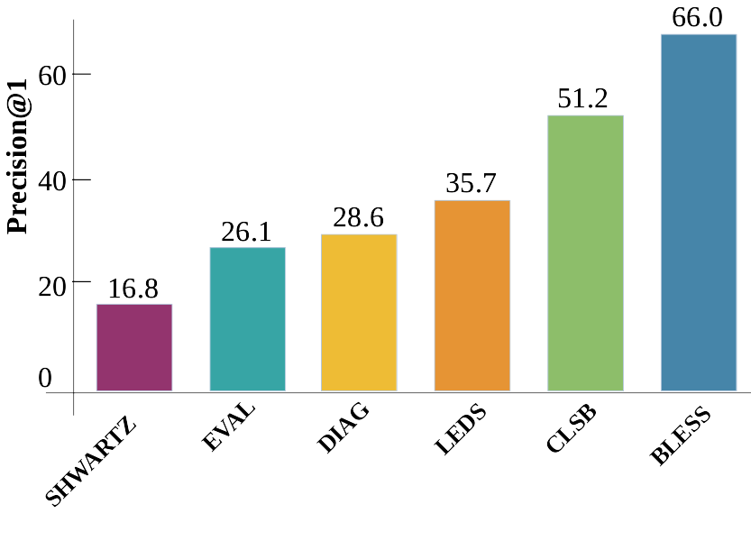
Results I: Anchor Validation
Quantitative evaluation of WordNet siblings (Schick and Schütze., 2020):
Key observations:
High precision of BLESS, CLSB, LEDS
Lower precision for other datasets due to concept diversity, e.g., low frequency and more abstract words
Notes:
Additionally, we did the quantitative evaluation over the six datasets using precision @1
We found that some datasets have lower precision due to the their complexity of frequency or concept abstractness
high precision 1 and other datasets are more difficult due to

Slide 18
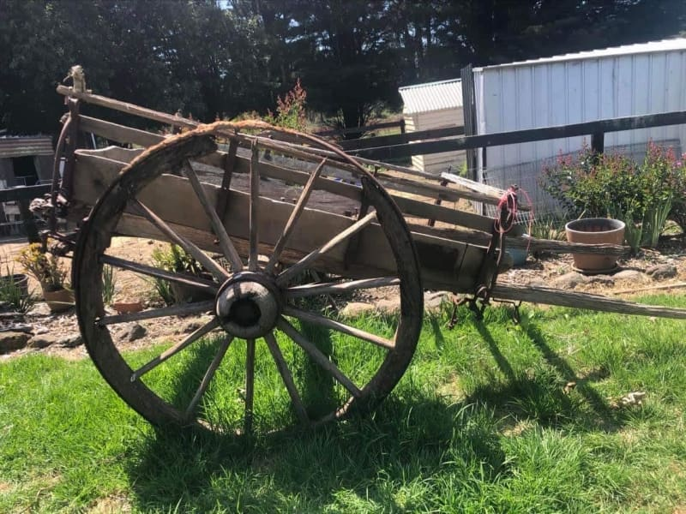
Examples: Hypernym Shifts with Anchors
Hypernym (Y) Predictions
X
Anchors
Raw Prompts
Anchored Prompts
Rare
dray
boat machine tool
vehicle cart wagon
wagon, tractor, cart, horse, yes
joy life pleasure
joy feeling emotion
Abstract
happiness
love, joy, good, personal, maybe
Notes:
Here, we show two examples of using anchors to help the hypernym extraction.
For example, for the rare word dray, which is a a vehicle used to haul goods.
The top 3 hypernyms from RAW prompts don’t include the hypernym vehicle, however, with the anchors such as wagon, tractor, vehicle is corrected predicted .
Similarly for the abstract word happiness, with the access to its anchors such as ‘love’, ‘joy’, the hypernym ‘emotion’ is ranked as the the 3rd prediction.

Slide 19
Error Analysis: When does anchoring hurt?
Sense ambiguity:
E.g.,: fan is a person or an appliance.
BERT predictions are skewed to a specific sense as selected by the anchor
Noisy anchors:
generic and irrelevant words (e.g., actually, yes)
topic-relevant but not siblings(e.g., wood and lake)
Notes:
Apart from the positive results from anchors, we also conduct error analysis to understand when does anchoring hurt
We found two main situations:
firstly, for highly ambiguous word, for example, fan can be a person or an appliance, while BERT predictions tend to skewed to a single sense, in this case, the hypernym will be biased towards the sense selected by the anchors
Secondly, when noisy anchors exist and ranked on the top
Including too generic anchors like actually or yes
And topic-relevant but not co-hyponyms or siblings relation, e.g., wood and lake.

